Slide 1



KFA CHATBOT: DEVELOPMENT AND DEPLOYMENT
FROM DATA COLLECTION TO MODEL DEPLOYMENT
NAMSAM KOYU RAI SHWOPNIL NAKARMI

Slide 2
INTRODUCTION
A chatbot is an AI-powered tool designed to simulate human-like conversations, providing instant responses and assistance. It can be used for customer support, information retrieval, task automation, and enhancing user experience through natural language understanding and interaction.

Slide 3
Objective:
To enhance student engagement, automate administrative support, and provide 24/7 instant assistance for admissions, academics, fees, and campus services.
Scope:
Admissions: Program details, eligibility, application status.
Academics: Schedules, exams, assignments, LMS support.
Student Services: Fees, scholarships, campus facilities.
Career Support: Internships, placements, resume tips.
Integration: Website, WhatsApp, LMS, CRM.
AI Features: NLP, multilingual, human handoff.
Impact: Faster responses, reduced workload, improved student experience.

Slide 4
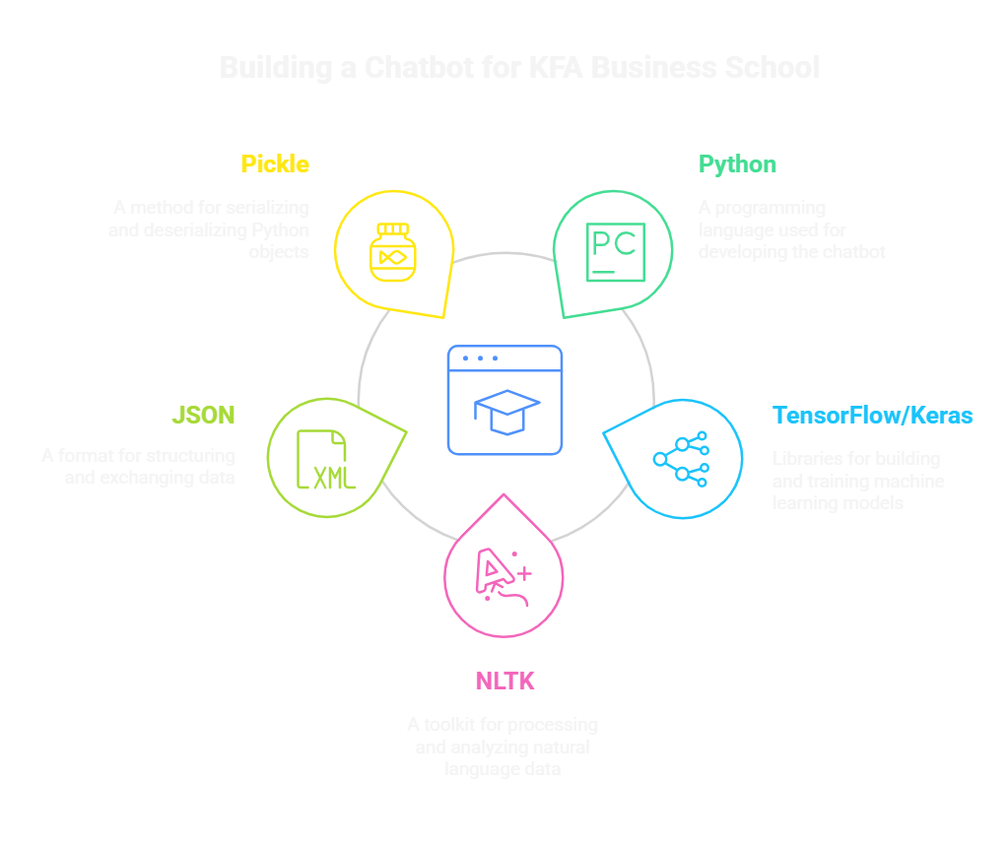
TECHNOLOGIES USED

Slide 5

DATA COLLECTION
1. Dataset Overview
Our dataset is a *JSON file* containing intents, patterns, responses, and context for training a chatbot. It is structured and well-organized, making it suitable for intent classification and response generation.
3. Dataset Structure
The dataset is structured as a *JSON object* with a single key "intents", which contains an array of intent objects. Each intent object has the following keys:
1. **tag**: The intent label (e.g., greeting, mba_program).
2. **patterns**: An array of example user queries for the intent.
3. **responses**: An array of possible bot responses for the intent.
4. **context**: An array of context tags for multi-turn conversations (optional).
2. Dataset Size
- *Number of Intents*: 24 (e.g., greeting, goodbye, about_kfa, mba_program, etc.).
- *Total Patterns*: ~200 (example user queries).
- *Total Responses*: ~100 (bot responses).
- *File Size: Depending on formatting, the JSON file is likely **10–20 KB* in size.

Slide 6
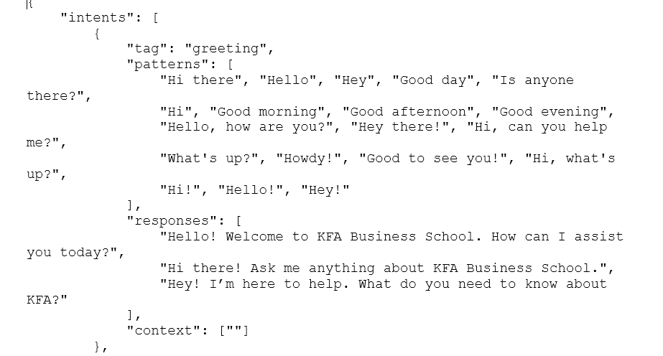

Slide 7
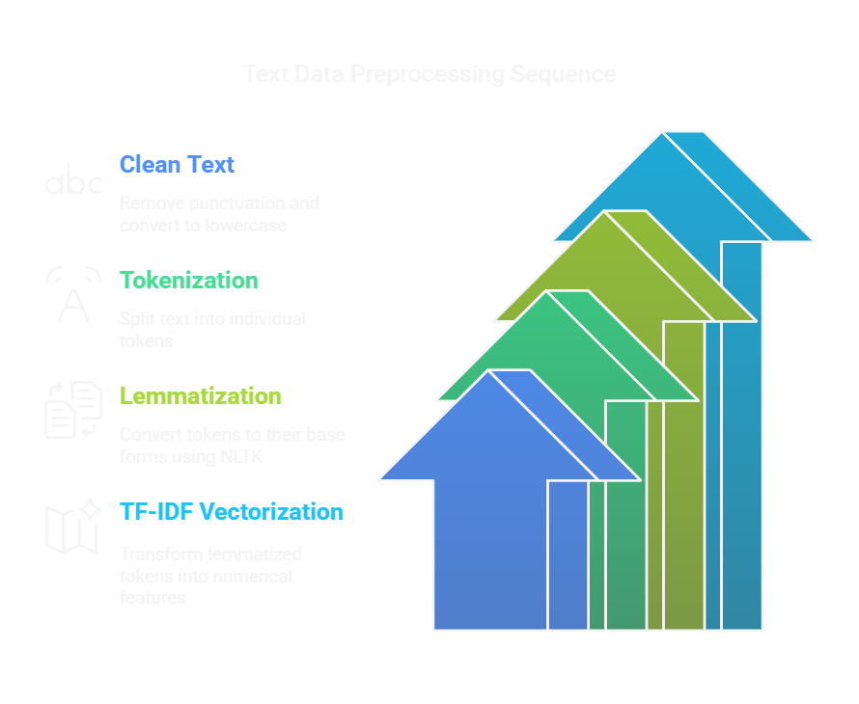
DATA PREPROCESSING TokenIZATION:

Slide 8
Splitting sentences into words using nltk.word_tokenize.
Lemmatization:
Reducing words to their base form using WordNetLemmatizer.
Bag of words:
Converting text into numerical vectors for model input.
Output:
words.pkl and classes.pkl: Preprocessed data saved for training.

Slide 9

MODEL ARCHITECTURE
MODEL TYPE:
Feedforward Neural Network (or LSTM, depending on your final model).
Layers:
Input Layer: Dense(128, input_shape=(len(words),))
Hidden Layer: Dense(64, activation='relu')
Output Layer: Dense(len(classes), activation='softmax')
Optimizer:
Adam optimizer with a learning rate of 0.001.
Loss Function:
Categorical Crossentropy (for multi-class classification).

Slide 10
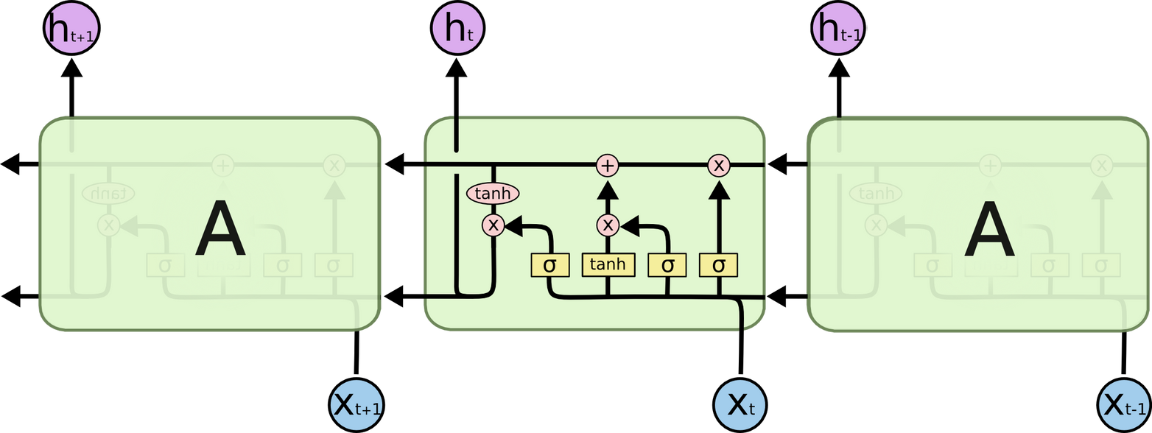
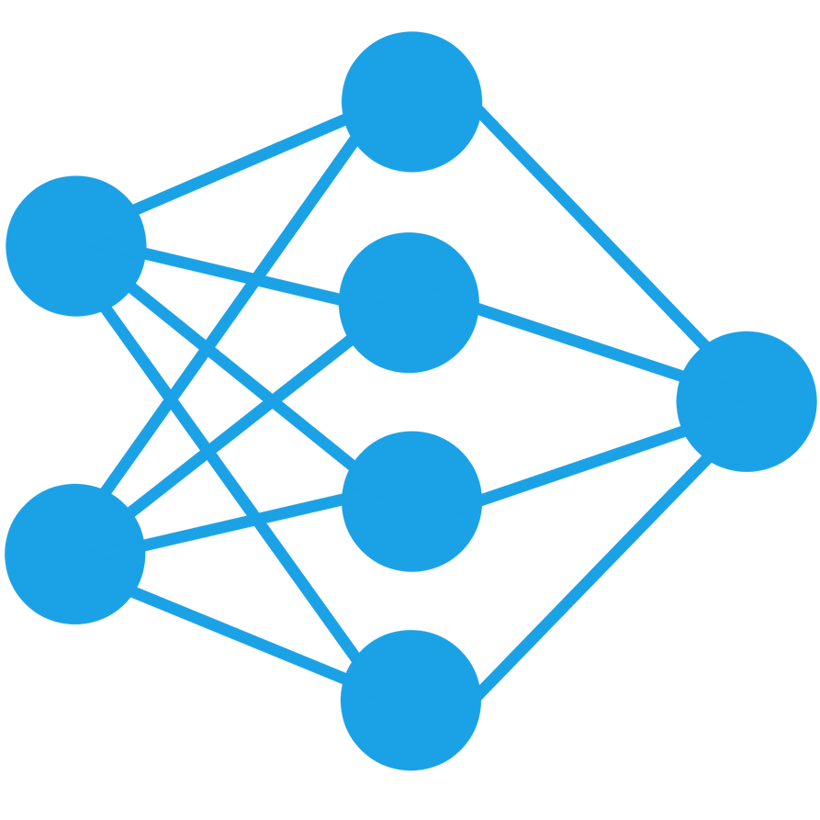

Slide 11

Split into trainX (features) and trainY (labels).
Training Process:
200 epochs with early stopping to prevent overfitting.
Evaluation Metrics:
Accuracy, Precision, Recall, F1-Score.
Model Saving:
Saved as kfabot.keras for deployment.
TRAINING THE MODEL
TRAINING DATA:

Slide 12
MODEL EVALUATION
CONFUSION MATRIX:
Visualize model performance using a heatmap.
Accuracy:
Report the model's accuracy on the test set.
Limitations:
Discuss any challenges (e.g., recognizing single-word inputs like courses).

Slide 13
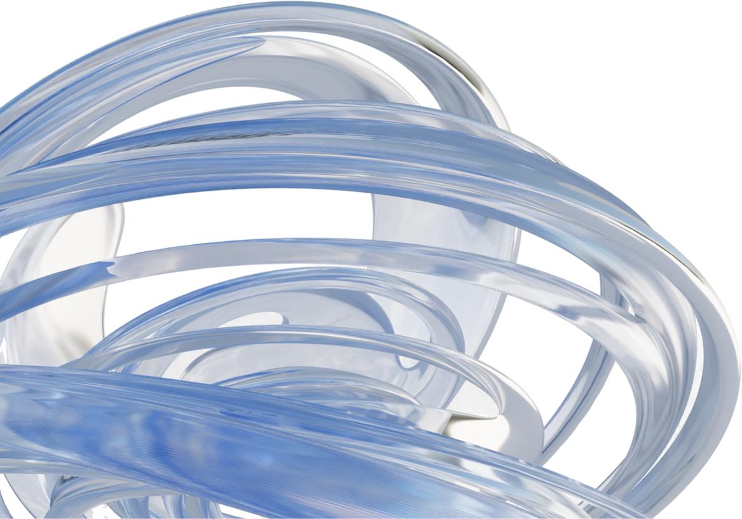
CHATBOT DEPLOYMENT
CHATBOT SCRIPT:
Load the trained model and preprocessed data.
Input Processing:
Convert user input into a bag of words.
Intent Prediction:
Use the model to predict the intent.
Response Generation:
Select a random response from the corresponding intent in intents2.json.

Slide 14

Working of Chatbot

Slide 15

CHALLENGES AND THEIR SOLUTIONS
Challenges:
Single-word inputs (e.g., courses) not recognized initially.
Input shape mismatch during model inference.
Solutions:
Added missing patterns to intents2.json.
Reshaped input to match the model's expected shape.

Slide 16
THANK YOU

